Slide 1
Prisoner's Dilemma
And how computer science is the best science

Slide 2
Introduction
AKA: The Problem

Slide 3

The Problem

Slide 4
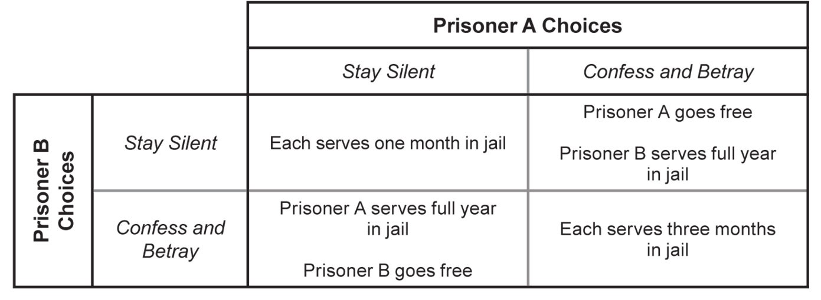
So what now?
Remember, you have no contact with your friend
2 Options
Confess / Defect
Stay silent / Cooporate

Slide 5
Help!

Slide 6
Part 1: Game Theory

Slide 7
Basic Overview of Game Theory
Game theory is "the study of mathematical models of conflict and cooperation between intelligent rational decision-makers.” -Wikipedia
In other words, how do you maximize rewards and minimize negative outcomes when competing and cooperating with other parties.
Applicable in everything from biology to economics.

Slide 8
Prisoner’s Dilemma According to Game Theory
Classic problem
The foundation for M.A.D.
Characteristics:
Symmetrical: Both parties have equal power
Non-Zero Sum: Net result is not necessarily 0, so both players can win or lose
Simultaneous: Players make their moves simultaneously
Imperfect Information: Each player does not know what the other one is doing
Discrete Game: Moves are discrete and binary

Slide 9
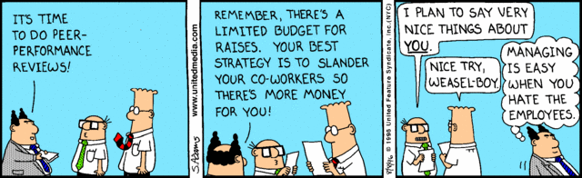
Prisoner’s Dilemma and its variant
Classic Prisoner's Dilemma
An optimal solution exists and is known for all cases:
Defect
Iterative Prisoner's Dilemma
Play more than once in succession
Players are aware of past moves of opponent and of themselves
Best solution depends on scenario
Can you win?

Slide 10
Part 2: Computer Science

Slide 11
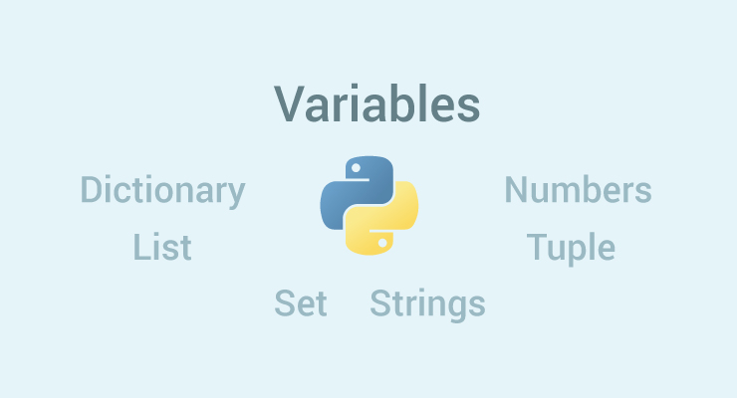
Variables
Different data types
Like a box
Declared dynamically
Can be operated upon (+, - , *, **, sqrt, abs(), …)
Can be compared (<, =, >, !=, …)
Arrays are referenced by index and start from 0, not 1!
Google it!

Slide 12
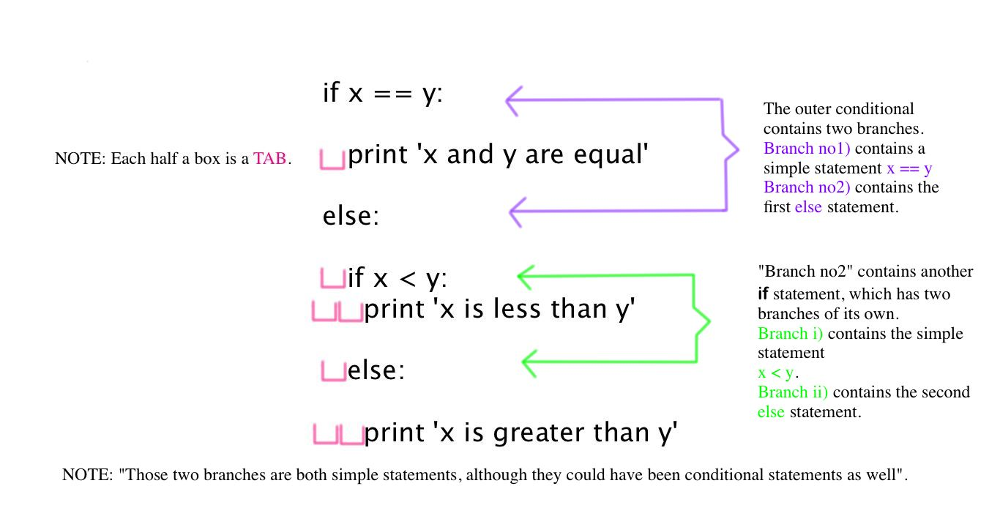
Conditionals
Code only runs if condition is met
Can string multiple ones along
If you don’t know the syntax, google it or ask us!

Slide 13
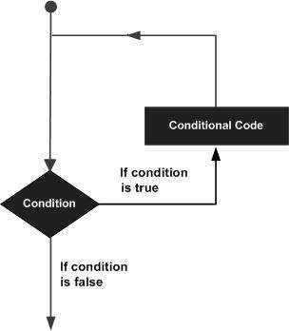
Loops

Slide 14
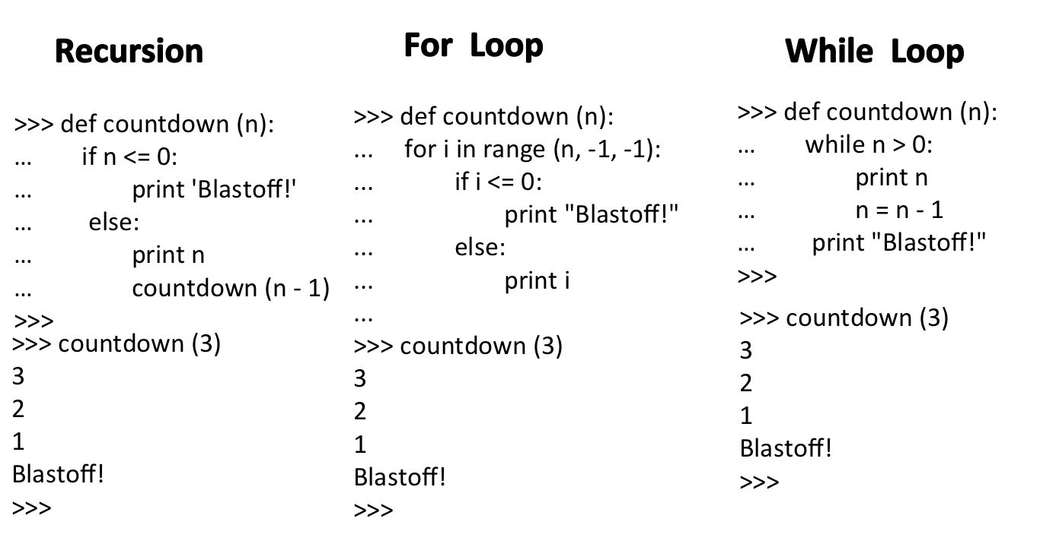
Loops
For loops:
Like ∑ (sigma)
Built in iterator for when you know how many times you want to execute the loop
While loops:
Like for loop
Continues until a condition is satisfied, typically a bool

Slide 15
Part 3: Freedom?

Slide 16
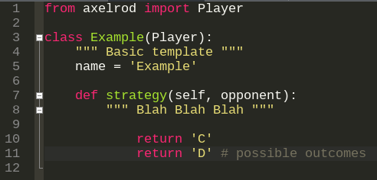
Implementation
Build a simple bot to destroy the others at Prisoner's Dilemma!
Use opponent.history[index_num] to reference the opponent history
Check your emails

Slide 17
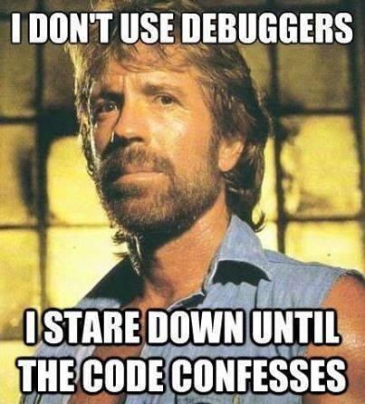
Good luck!

